Slide 1
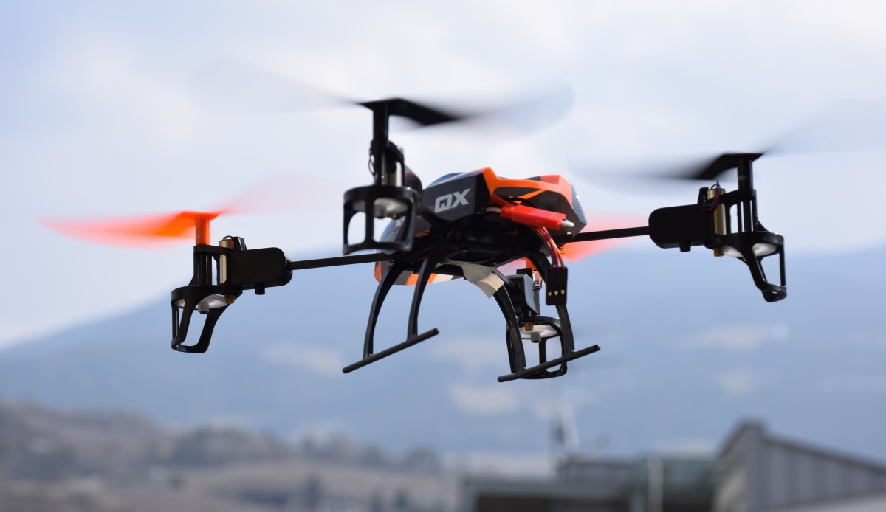
INGENZI QUADICOPTER PRELIMINARY DESIGN WITH COAXIAL ROTORS
AUBIN JOANES IGIRANEZA
AEROSPACE ENGINEER
Notes:
Hello everyone, welcome to our presentation today we will try to explain what we have done so far regarding our project. In this project our team has designed a light helicopter with its primary mission being cheap in and inter city transportation of passengers. The city of operation is chosen to be Istanbul – a busy city where sometimes traffic makes it hard for people to travel. The helicopter that we designed is capable of carrying 3 passengers and 1 pilot with a baggage allowance of 17kg for everyone in the cabin. The primary focus in this project was to make the helicopter light while at the same time satisfying the noise limitations, cruise speed and range requirements. This is the end of introduction, berk will continue with outline, and requirements.

Slide 2
Outline
1) Requirements
2) Market & Competitor Study
3) Overall Specifications
4) Engineering Drawings
5) References

Slide 3
Requirements
Minimum requirement
Mission: Last Mile Delivery
Maximum Takeoff Weight: 14 Kg
Communication range: 5 Km
Endurance: 30 min
Additional requirement
Configuration: Multirotor UAV
Landing Gear: standard
City of Operation: Kigali, Rwanda
Stable and Safe

Slide 4
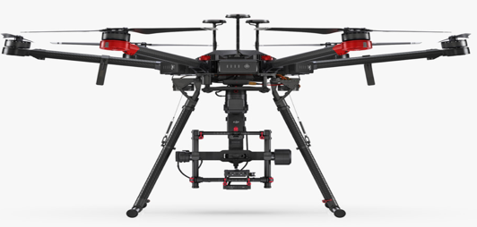
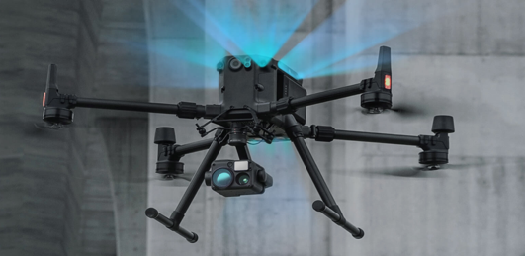
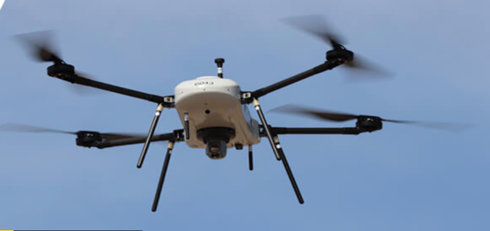
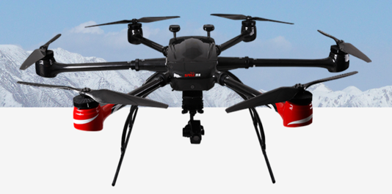
Market & Competitor Study
UAV | Diagonal wheelbase | Maximum takeoff weight | Max Altitude |  | Hovering time | Propulsion system |  | communication range | Battery
DJI Matrice 600 Pro | 1133mm | 15.5 kg | 2170R propellers: 2500 m | 2195 propellers: 4500 m | No payload: 32 min, 6 kg payload: 16 min | Motor model: DJI 6010 | propeller model: DJI 2170R | FCC Compliant: 3.1 mi (5 km) | Model: TB47S Capacity: 4500 mAh Voltage: 22.2 V Battery Type: LiPo 6S Net Weight: 595 g
DJI Matrice 300 RTK | 895mm | 9 kg | 5000 m with 211propellers | 7000 m with 2195 propellers | No-load hovering time: 55 min | Motor model: DJI 5108 Motor | propeller model: 2195T Foldable Propellers | NCC/FCC: 15 km CE/MIC: 8 km | Name: WB37 Intelligent Capacity: 4920 mAh Voltage: 7.6V Type: LiPo Energy: 37.39Wh
THOR VTOL mini UAS | 2.06m | 21 kg | 3657 m |  | <70 min ﬂight endurance | - |  | 10 km | -
KWT-X6L-15 Multi-rotor UAV | 1765±10mm | 37.5 kg | 5000m |  | No-load hovering time : ≥75min 15kg load hovering time: ≥30min | Propeller Size: 812mm |  | ≥7km | 12S 26000mAh

Slide 5
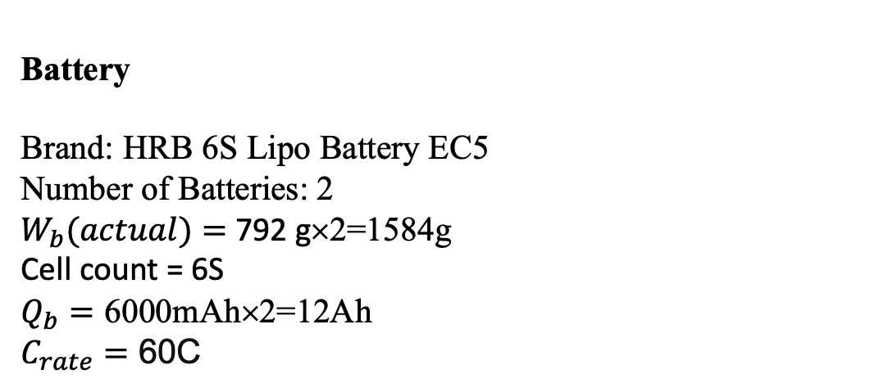
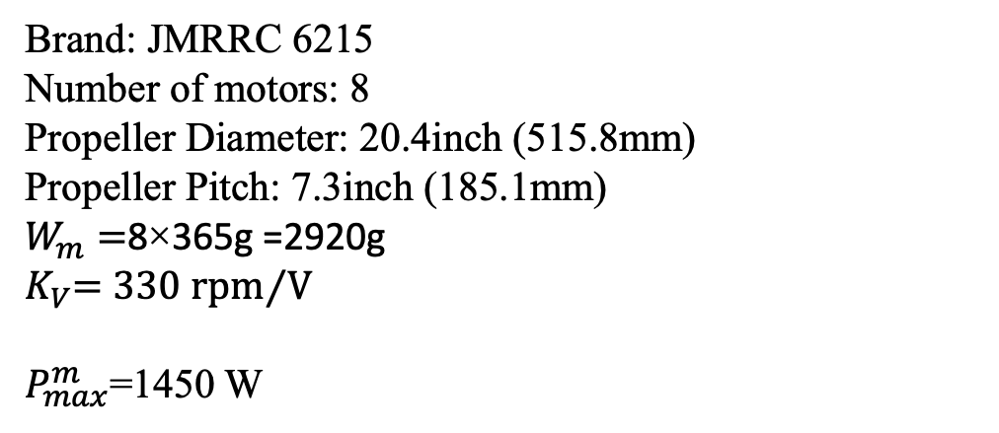


INGENZI UAV Specifications
Motor and Propeller
$W_{pl}$= 5 kg
Brand: JMRRC 6215
Number of motors: 8
Propeller Diameter: 20.4inch (515.8mm)
Propeller Pitch: 7.3inch (185.1mm)
$W_{m}=$8×365g =2920g
$K_{V}$= 330 rpm⁄V
$P_{max}^{m}$=1450 W
$$\frac{W_{e}}{W_{o}}=0.386$$
$$W_{e}=5.18 kg$$
Battery
Brand: HRB 6S Lipo Battery EC5
Number of Batteries: 2
$W_{b}(actual)=$ 792 g×2=1584g
Cell count = 6S
$Q_{b}=$ 6000mAh×2=12Ah
$C_{rate}=$ 60C

Slide 6
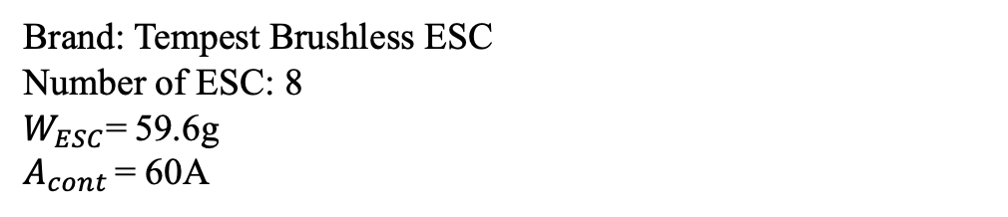
Electronic Speed Controller
Brand: Tempest Brushless ESC
Number of ESC: 8
$W_{ESC}$= 59.6g
$A_{cont }$= 60A
Radio transmitter and Receiver
Brand: DJI Cendence S Remote Controller
Display: It features a 5.5-inch 1920x1080p
Maximum Transmission Distance: up to 7 kilometers in unobstructed environments
Maximum service ceiling
maximum flight distance at 500 meters from the initial takeoff location

Slide 7
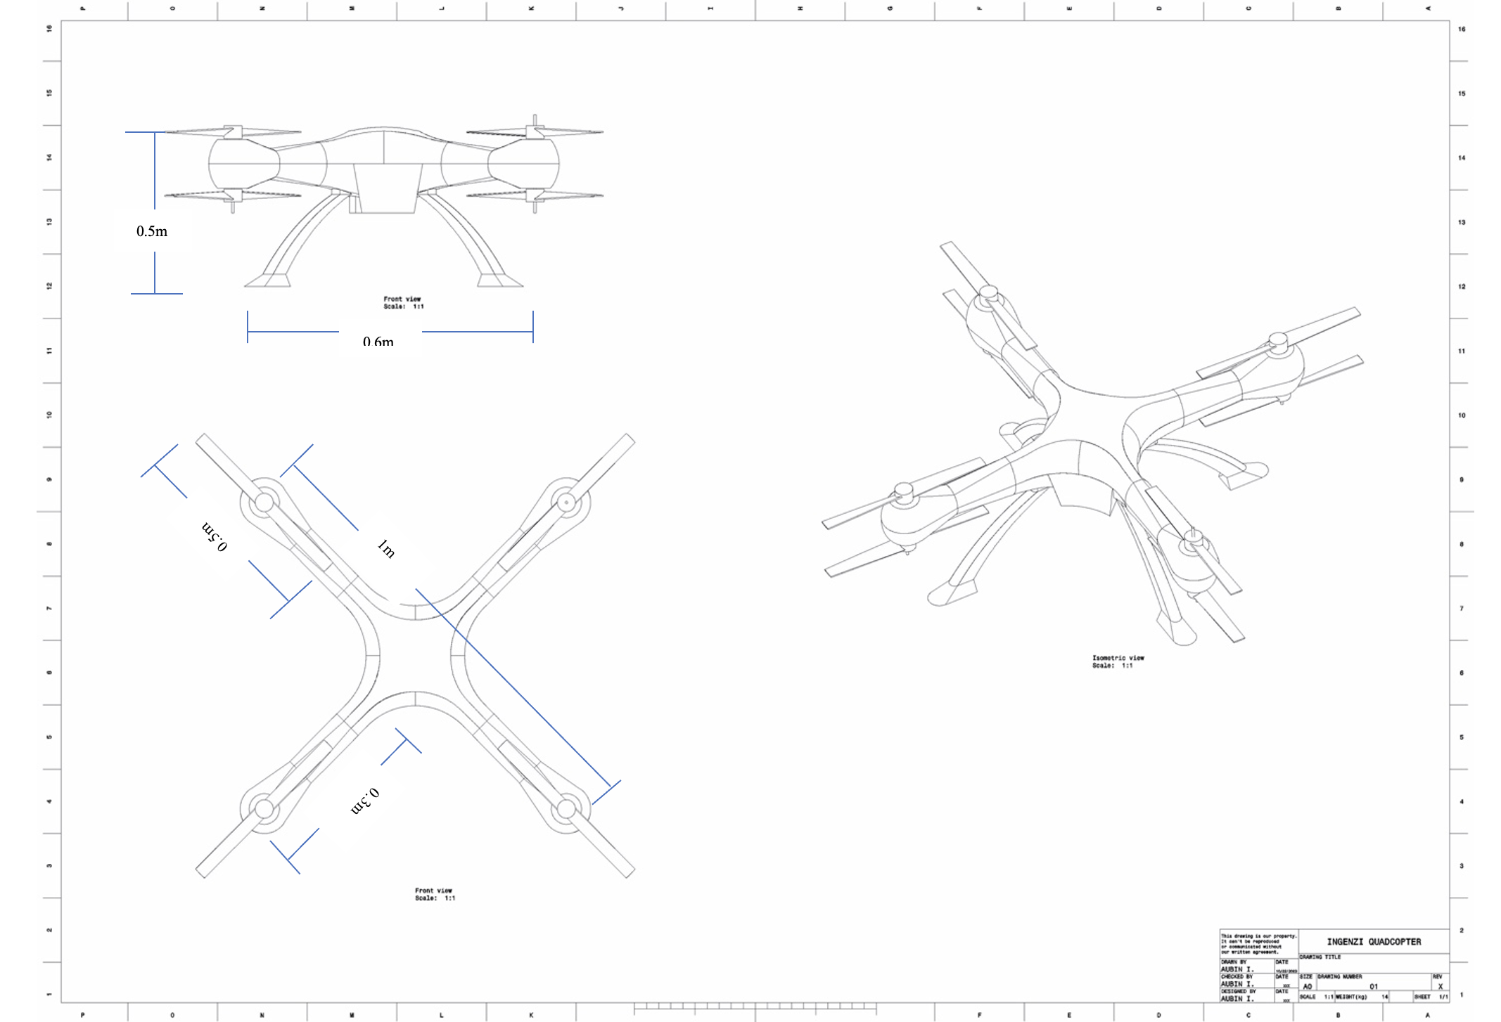
Technical Drawing of Quadcopter

Slide 8
Why I chose the Coaxial rotor over traditional rotors
Enhanced Stability
Increased Lift Capacity
Efficient Design
Redundancy and Reliability
Low Noise

Slide 9
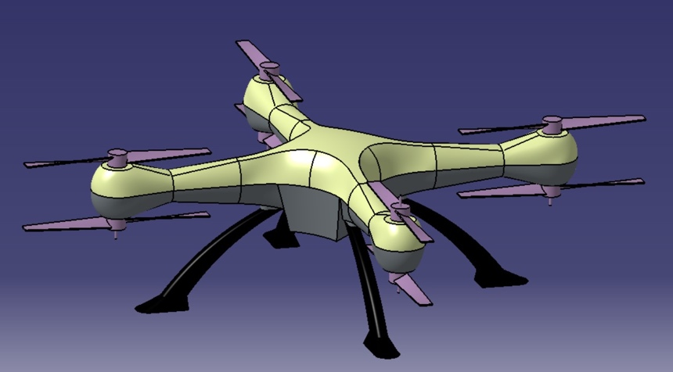
3D drawing of Quadcopter

Slide 10
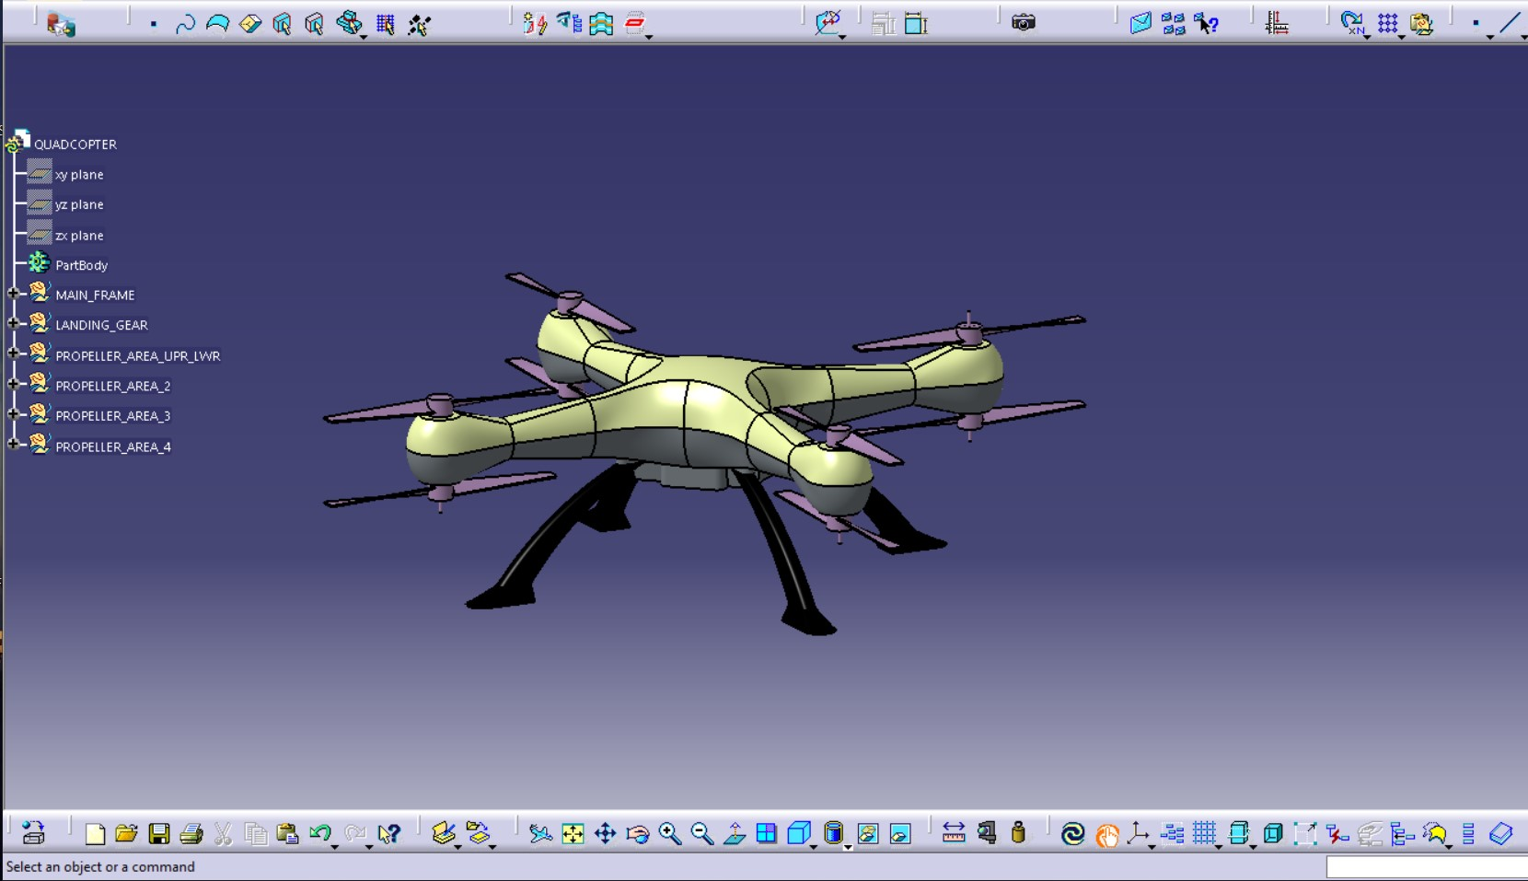

Slide 11
REFERENCES
1.DJI matrice 600 pro - DJI. (2017, April 18). DJI Official. https://www.dji.com/matrice600-pro
2.Specs. (n.d.). DJI. https://enterprise.dji.com/matrice-300/specs
3. (n.d.). You are being redirected... https://elbitsystems.com/media/LegionX_THOR-2-Web.pdf
4.X6L-15-Shenzhen Keweitai enterprise development CO.,LTD. (n.d.). Shenzhen Keweitai Enterprise Development CO.,LTD. https://www.alltechuav.com/x6l15
5.Robotics, T. (2022, 1). What is an electronic speed controller & how does an ESC work. Tyto Robotics. https://www.tytorobotics.com/blogs/articles/what-is-an-esc-how-does-an-esc-work
6.How high can a drone fly. (2022, December 10). Drones Survey Services. https://dronesurveyservices.com/how-high-can-a-drone-fly/

Slide 12

THANK YOU! IF YOU HAVE ANY QUESTIONS, FEEL FREE TO ASK THEM.

